Slide 1
NAAN MUDHALVAN SALESFORCE DEVELOPER PROJECT TITLE: BUILD AN EVENT MANAGEMENT SYSTEM
TEAM MEMBERS COURSE INSTRUCTOR
SOWNDHARYA S (620120104097) Prof. S. DHAMODARAN M.E.,
SOWMIYAA P (620120104096)(TEAM LEAD)
Priyadharshini r(620120104312)
Sri swetha devi m(620120104314) college spoc
Vidhya sri r(620120104318) Dr.R.VISHWANATHAN M.E., Ph.D.,

Slide 2
PROJECT GOAL:
The goal of building an event management system is to create a software application or platform that streamlines the planning, organization, and execution of various types of events. The primary objective of an event management system is to make the process of planning and executing events as efficient and stress-free as possible, ensuring a positive experience for both event organizers and attendees. It can save time, reduce manual tasks, and help make events more successful and enjoyable.
PROJECT DESCRIPTION:
The project aim is to provide real-time knowledge for all the students who have basic knowledge of Salesforce and Looking for a real-time project. This project will also help those professionals who are in cross-technology and want to switch to Salesforce. With the help of this project they will gain knowledge and can include it into their resume as well. The event management system is a comprehensive software solution designed to facilitate the seamless planning, organization, and execution of events of various scales and types. This system aims to empower event organizers, attendees, and stakeholders with a set of powerful tools that streamline the entire event lifecycle

Slide 3
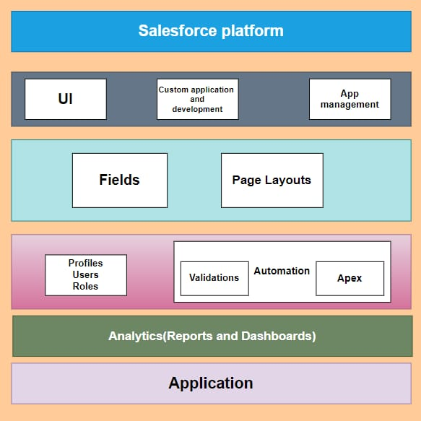
TECHNICAL ARCHITECTURE

Slide 4
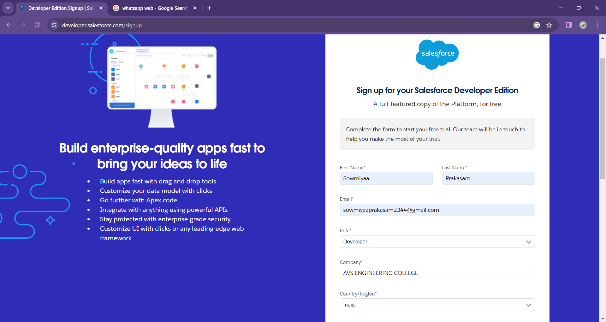
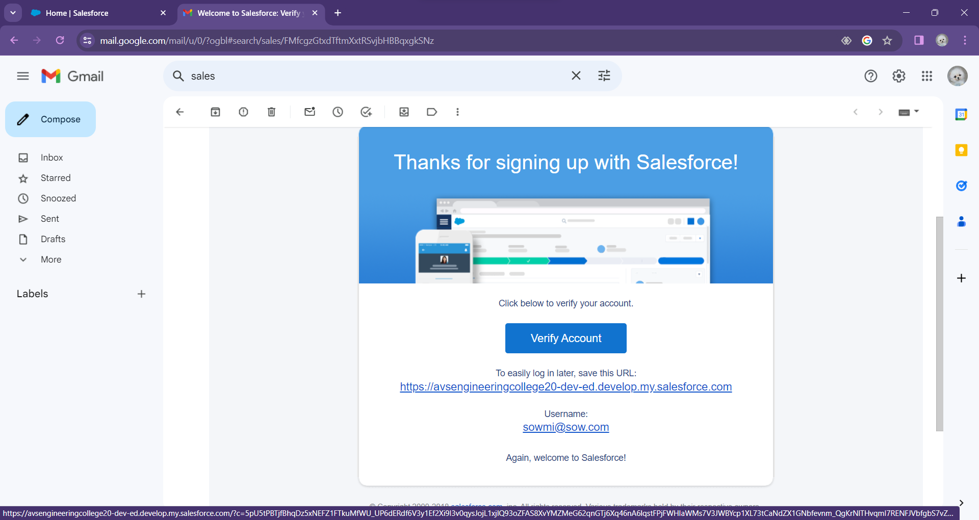
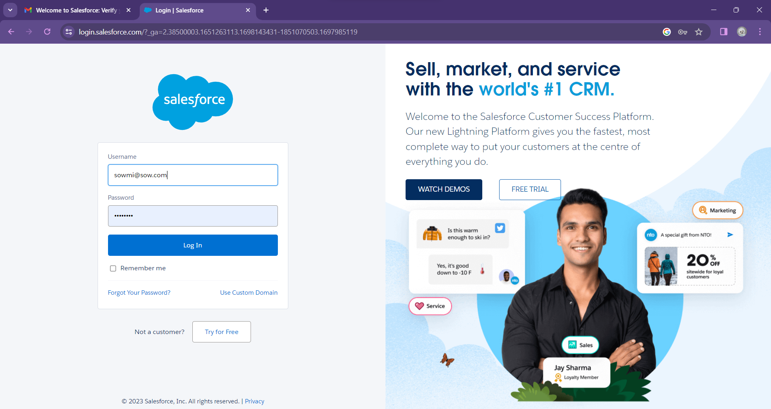
SALESFORCE DEVELOPER ORG:

Slide 5
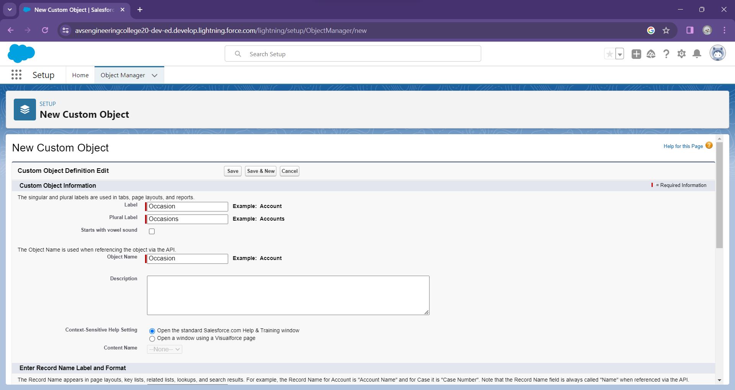
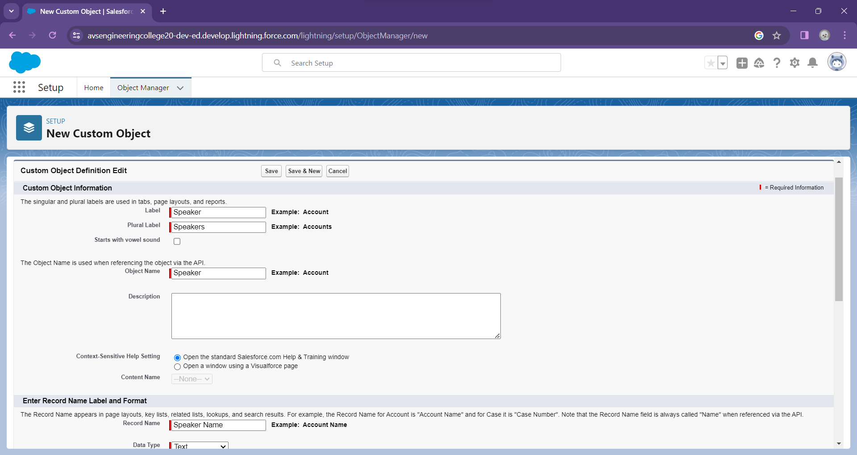
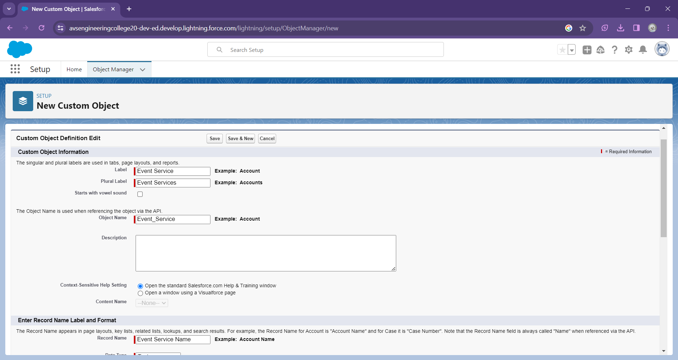


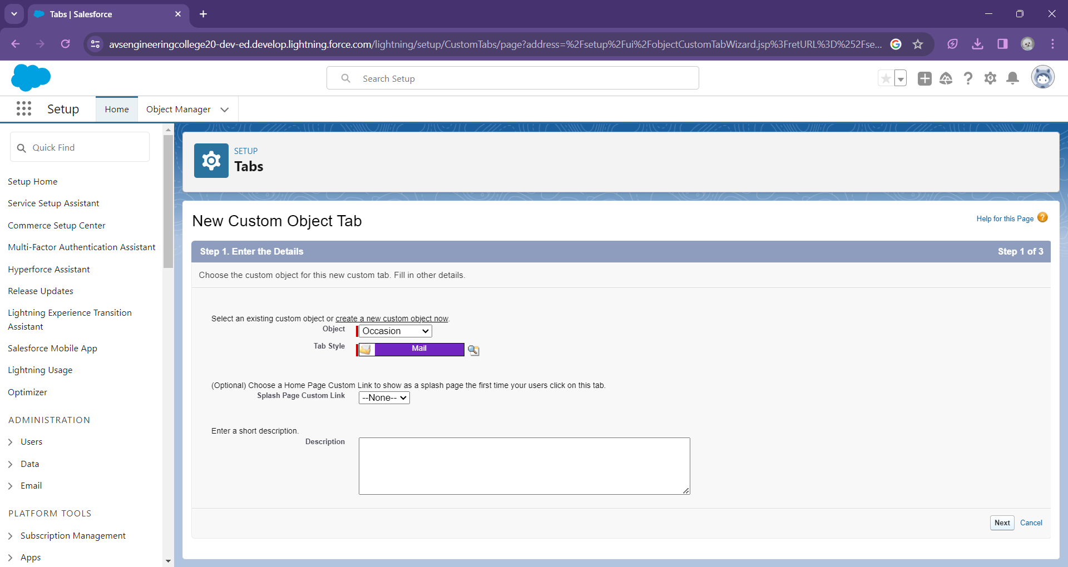
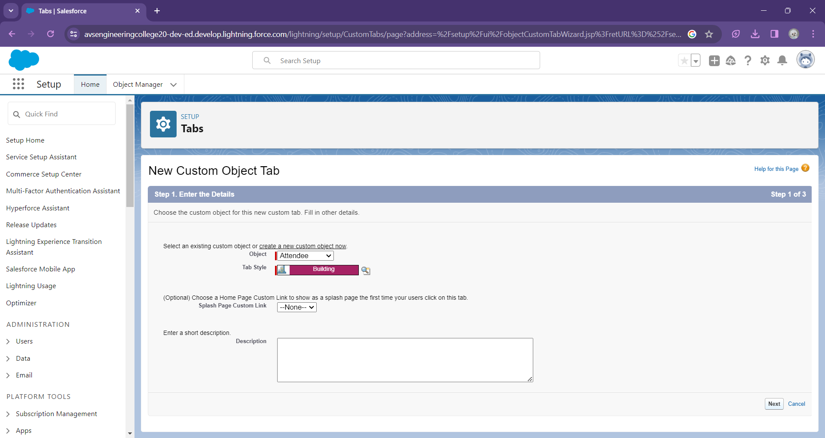
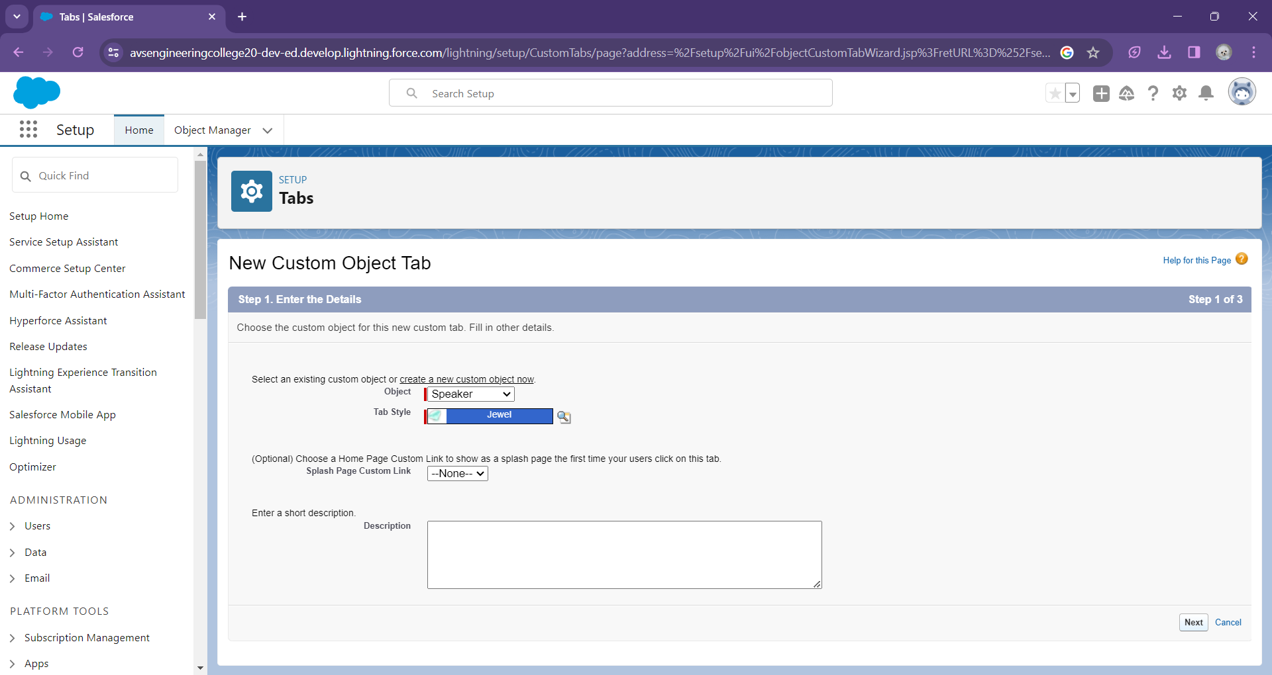


CUSTOM CREATION AND TABS:

Slide 6
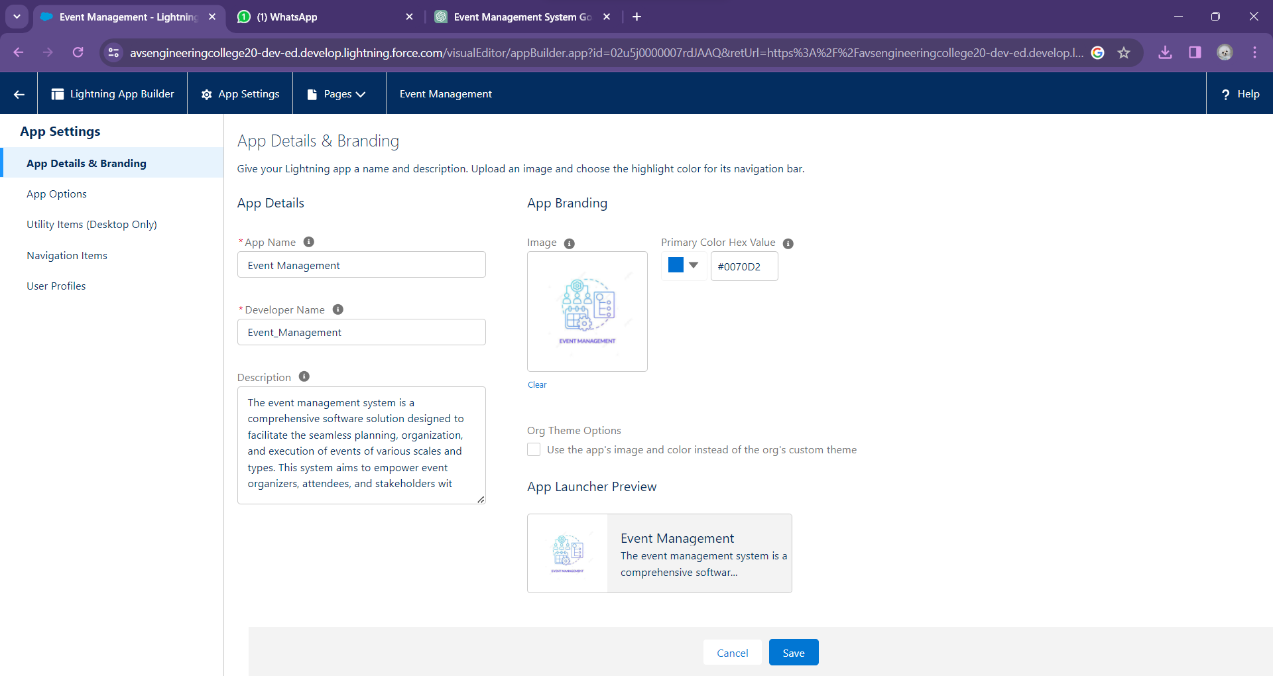
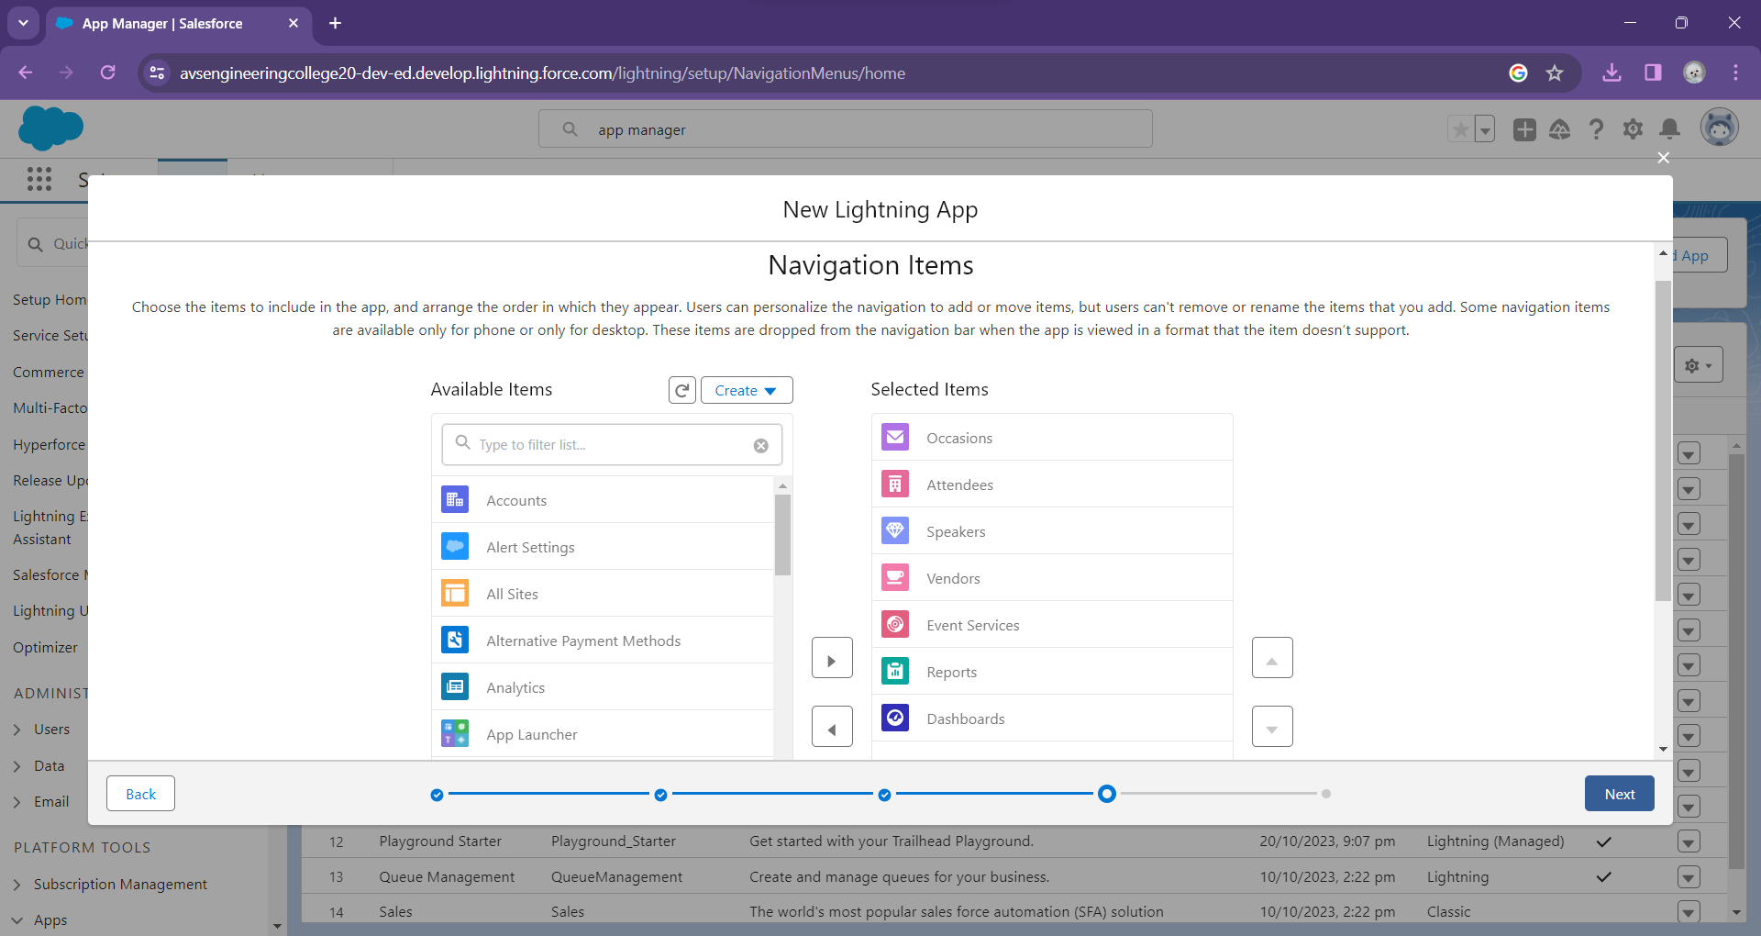
LIGHTNING APP:

Slide 7
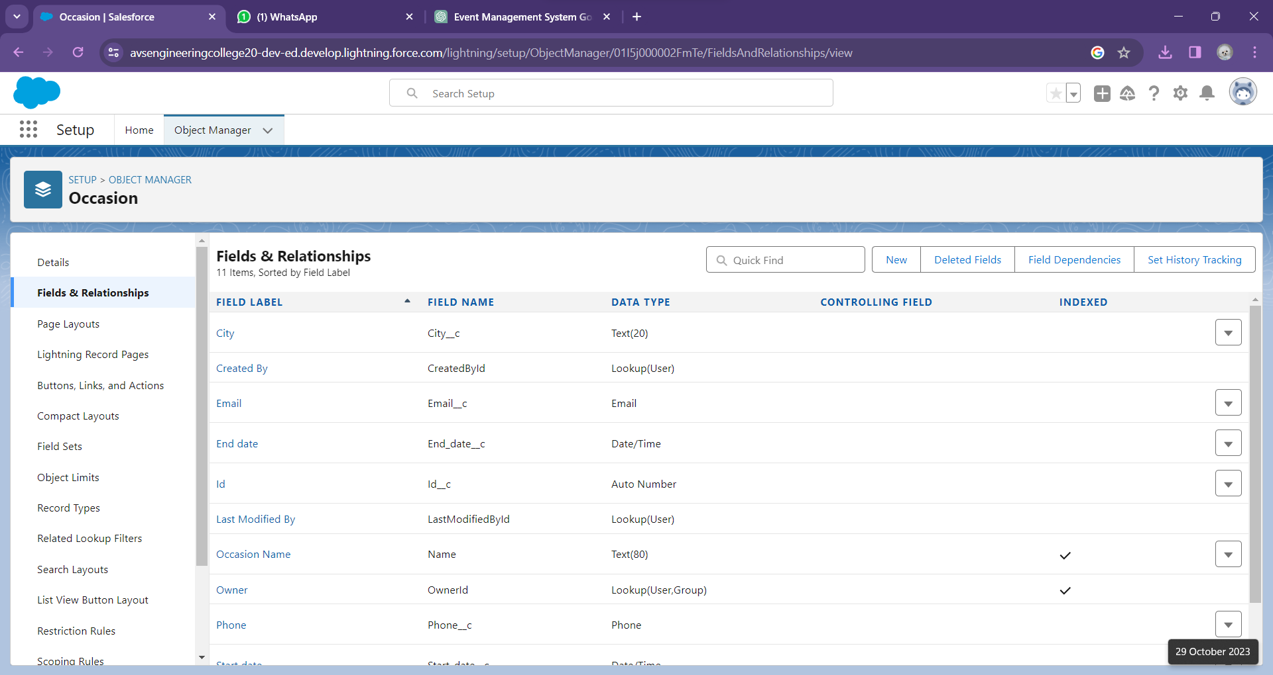
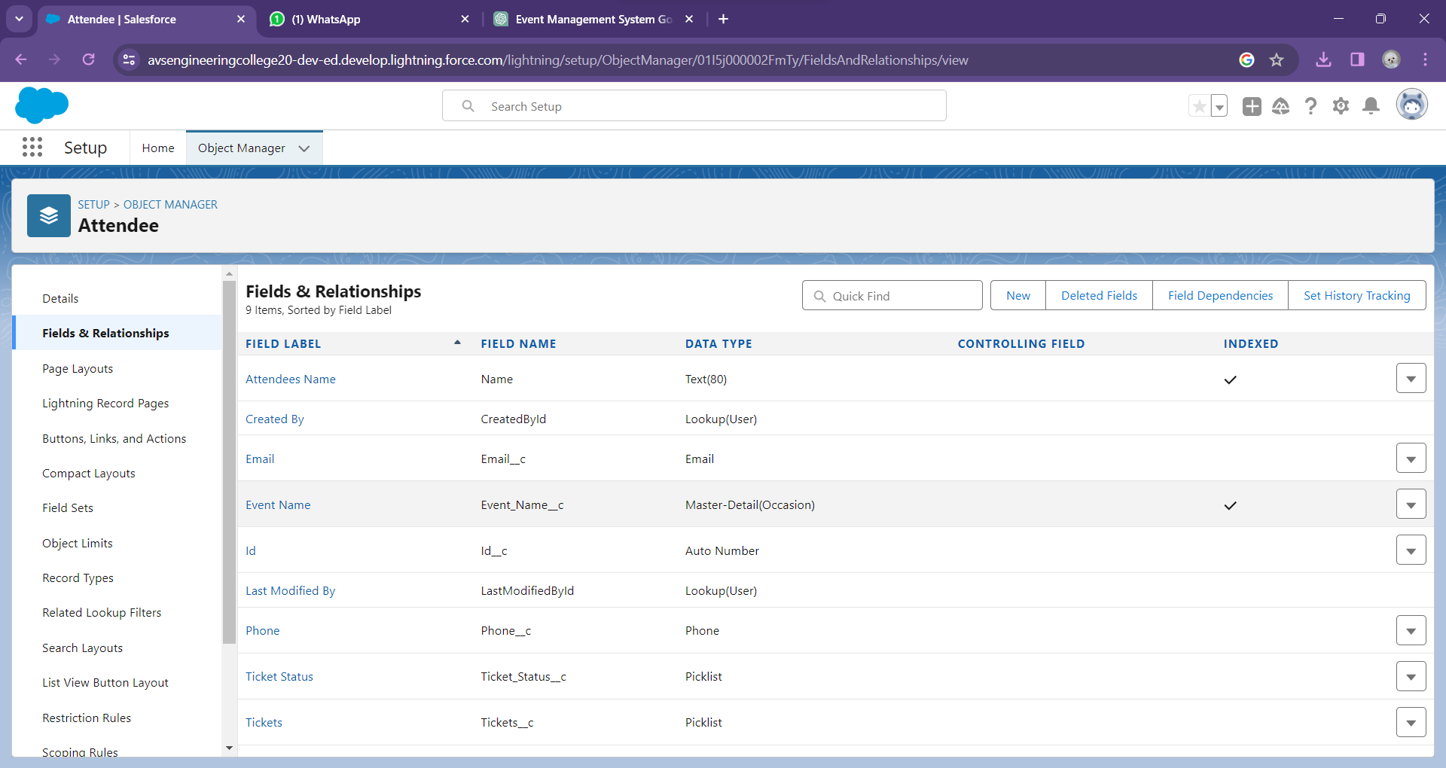

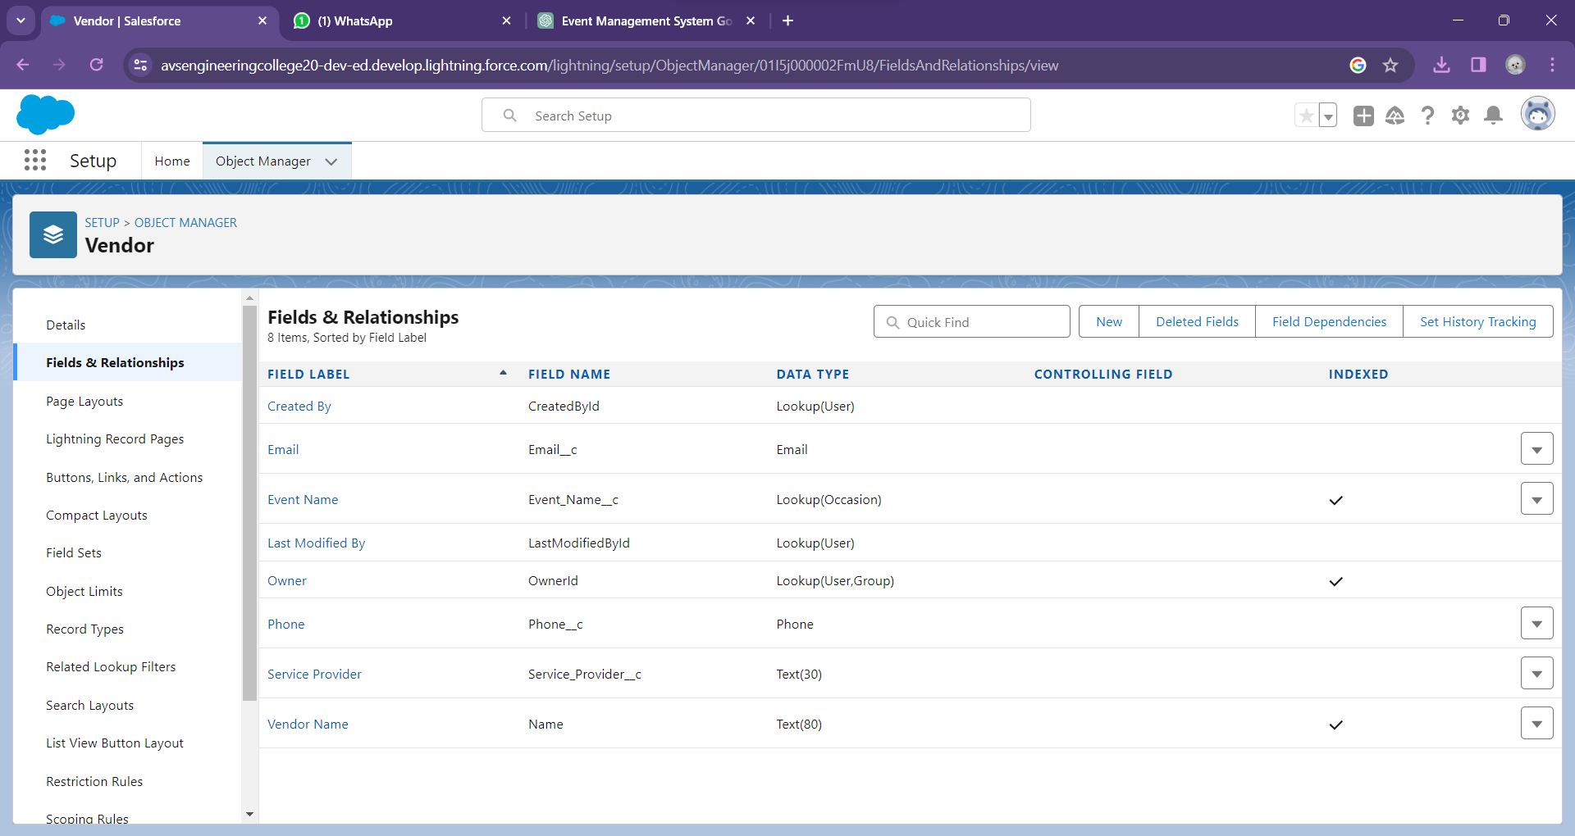
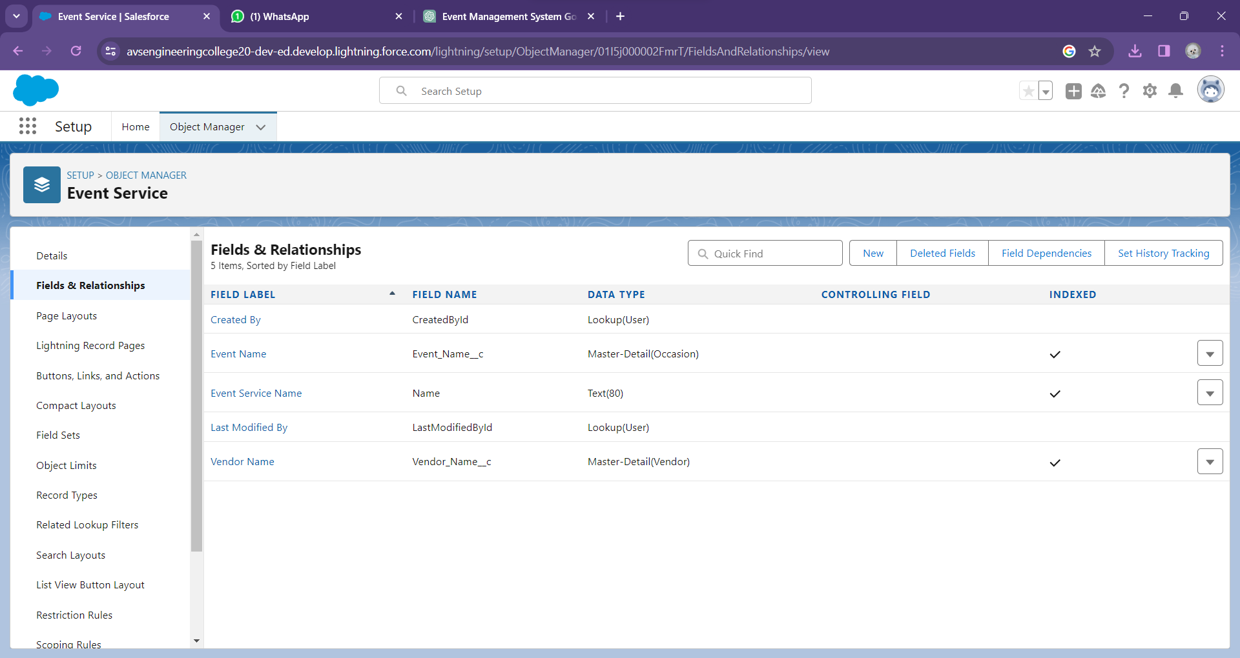
FIELDS AND RELATIONSHIPS:

Slide 8
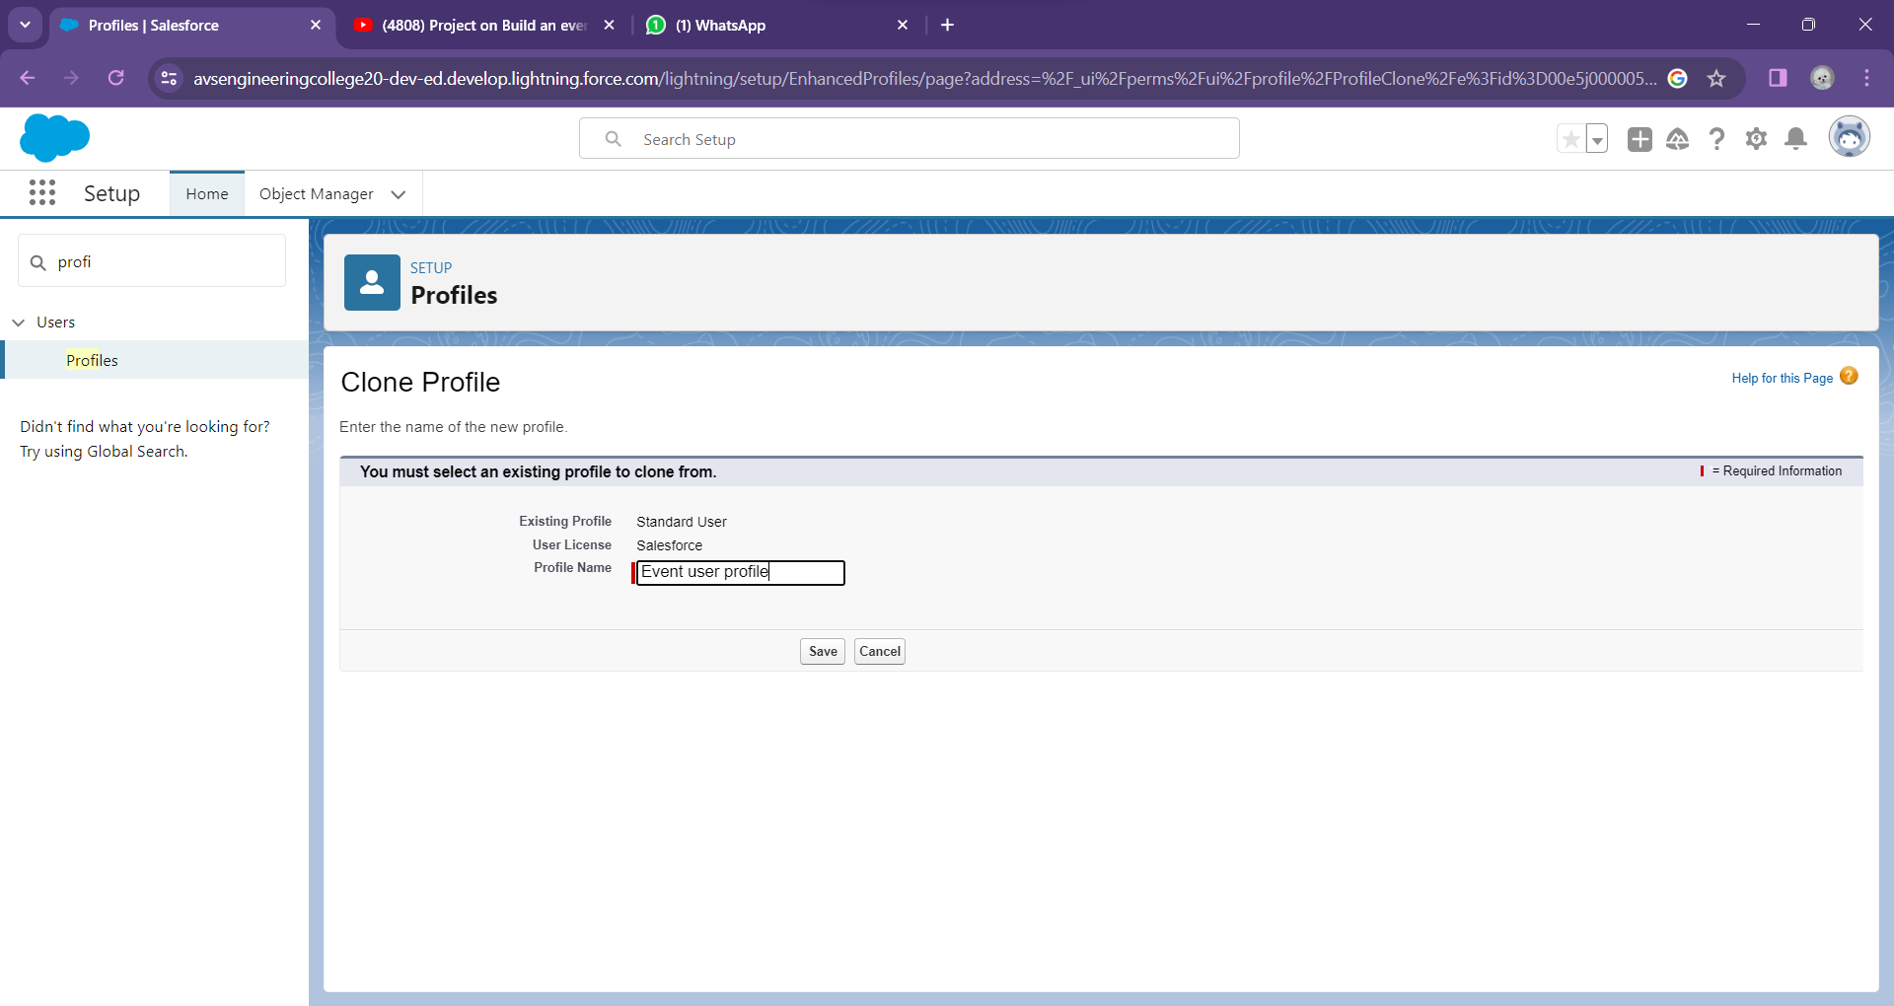
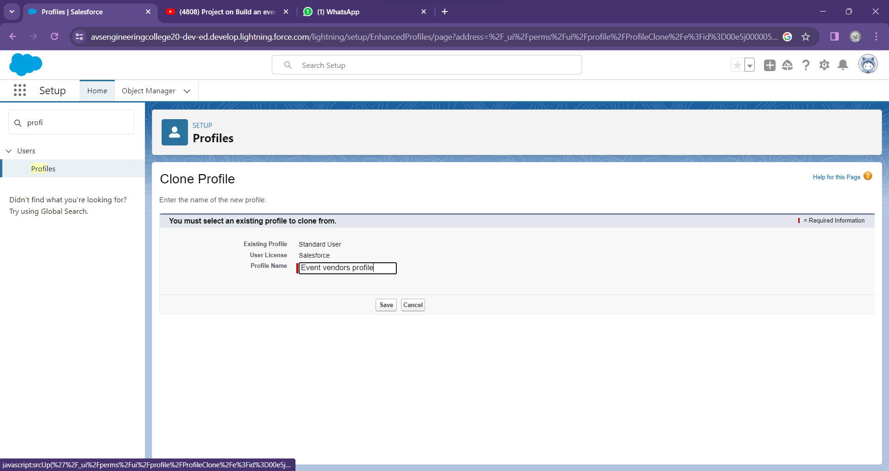
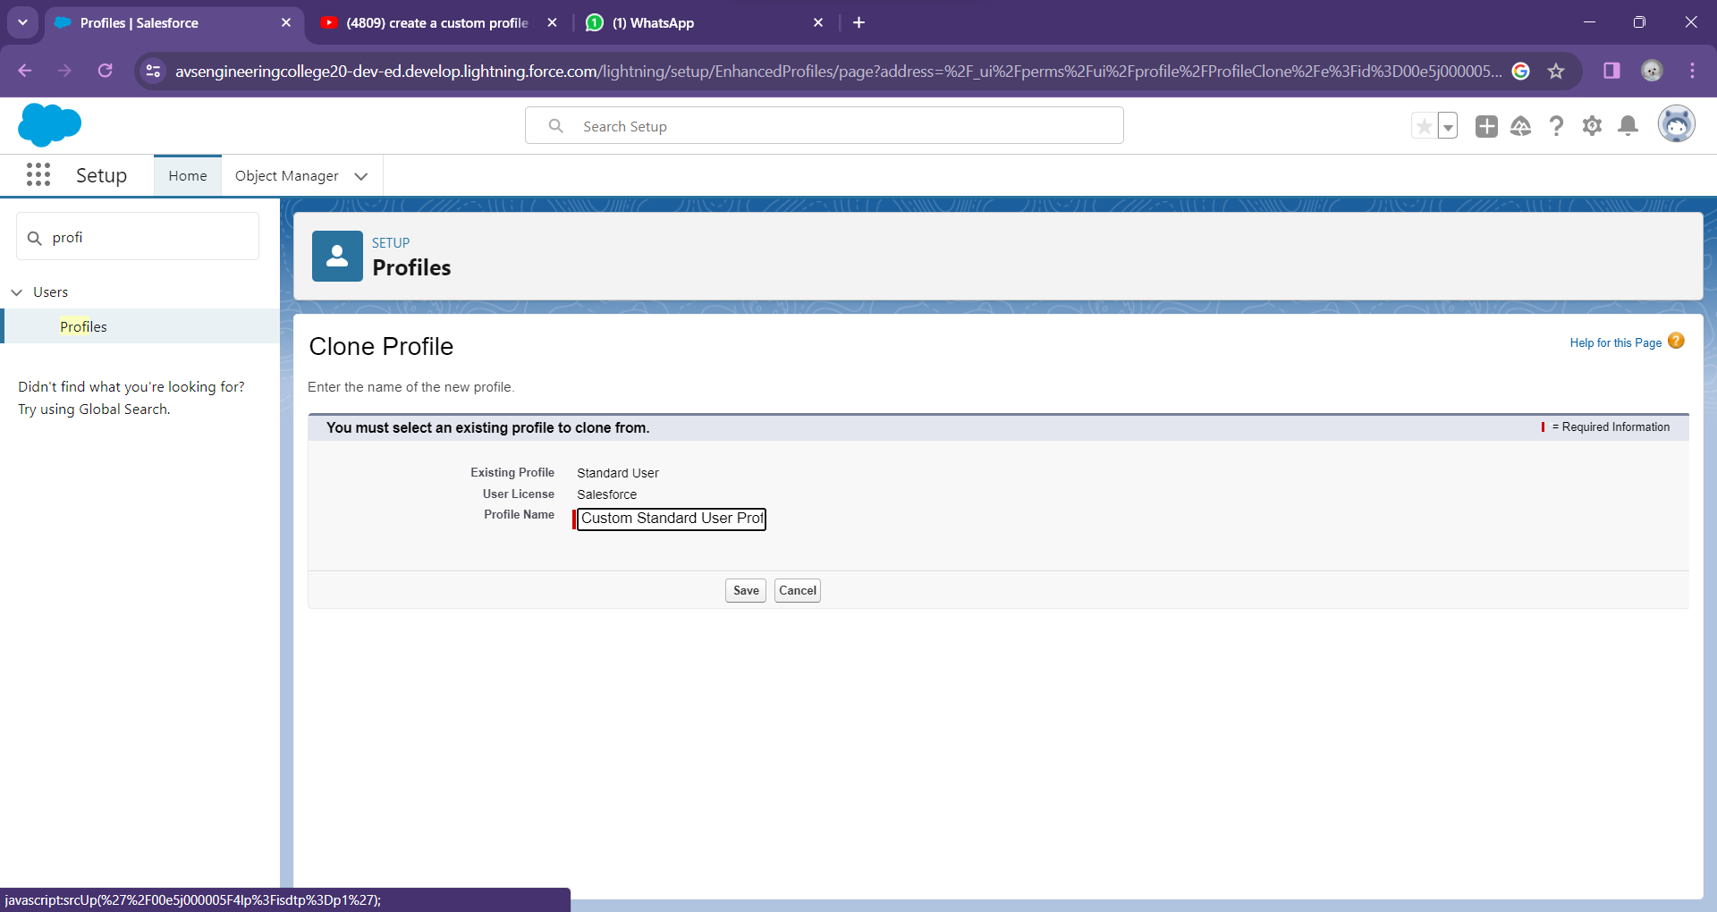
PROFILE:

Slide 9
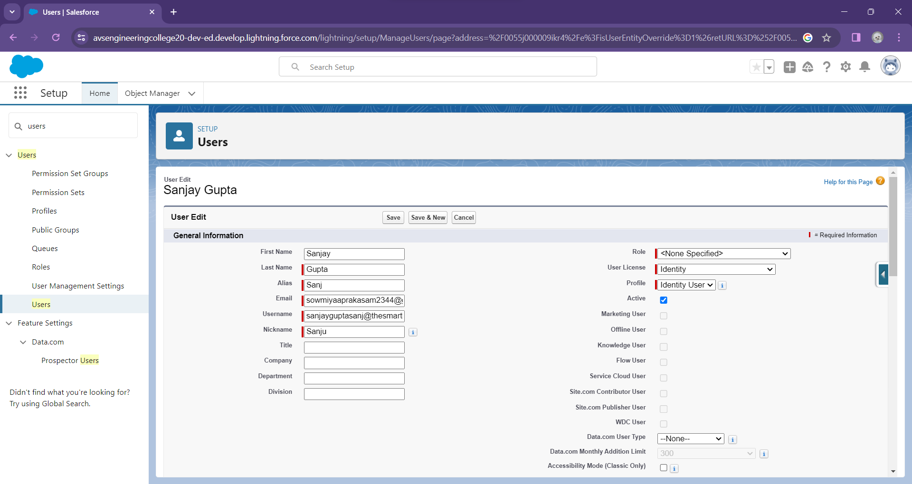

USER:

Slide 10
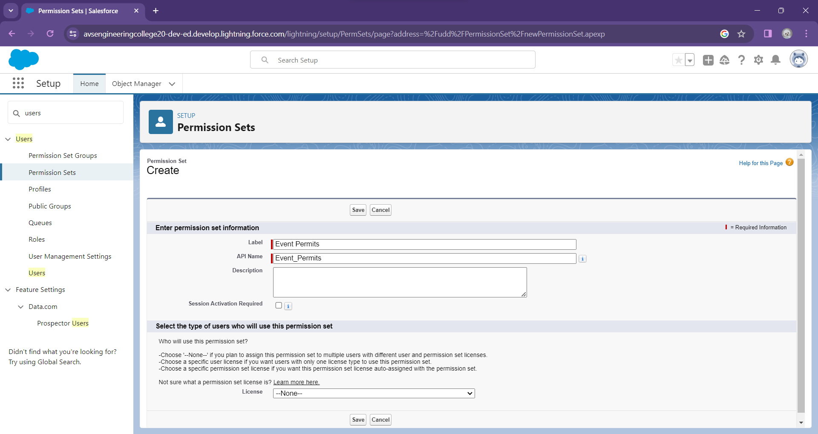
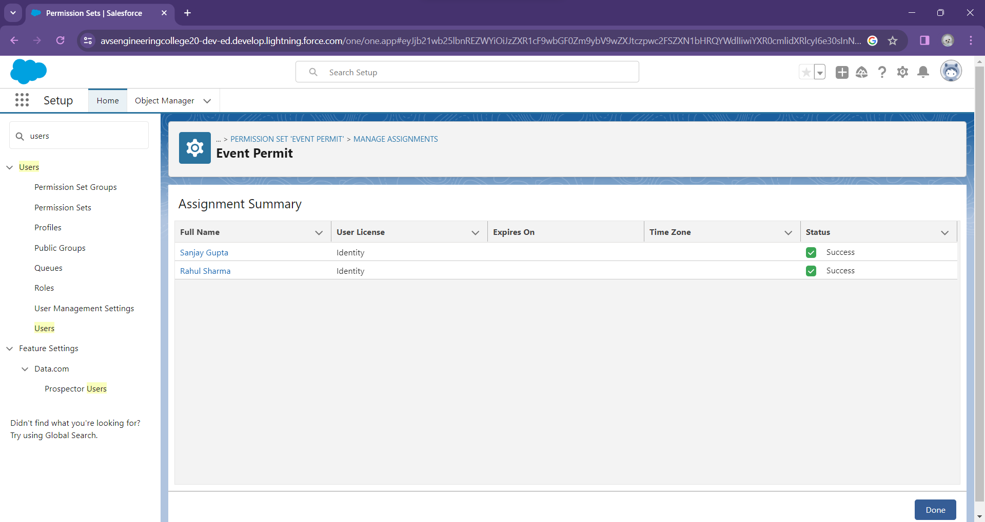

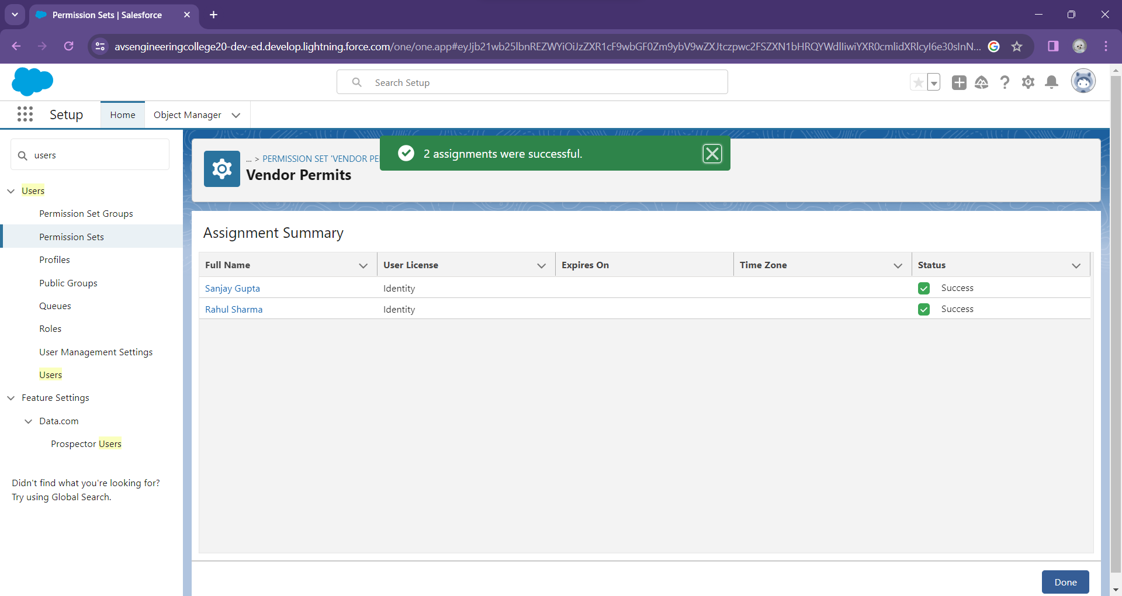
PERMISSION SETS:

Slide 11
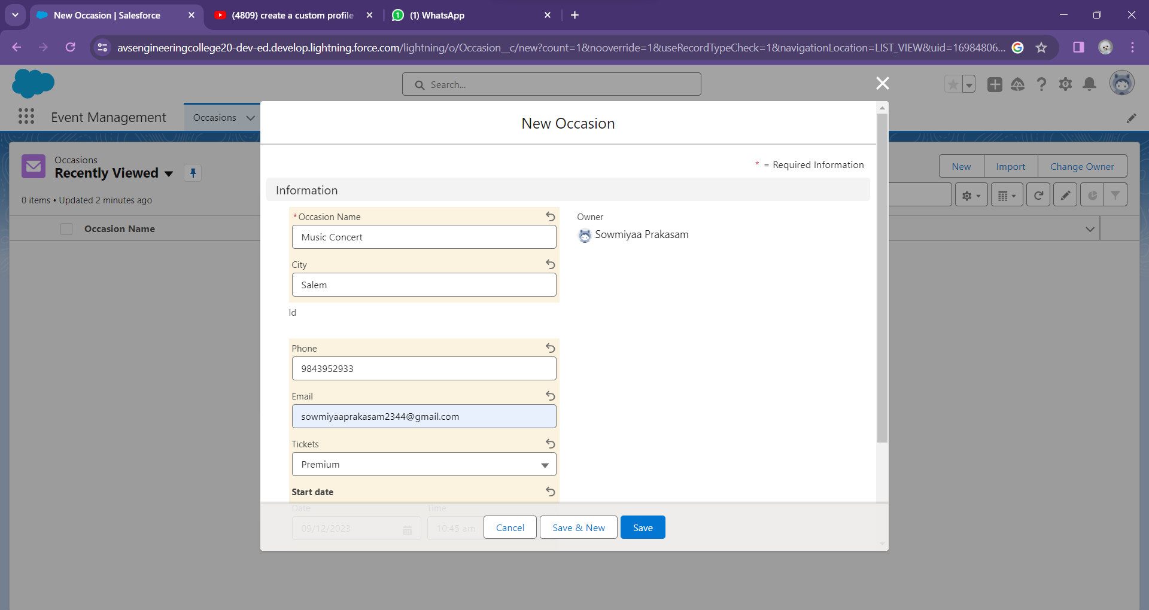
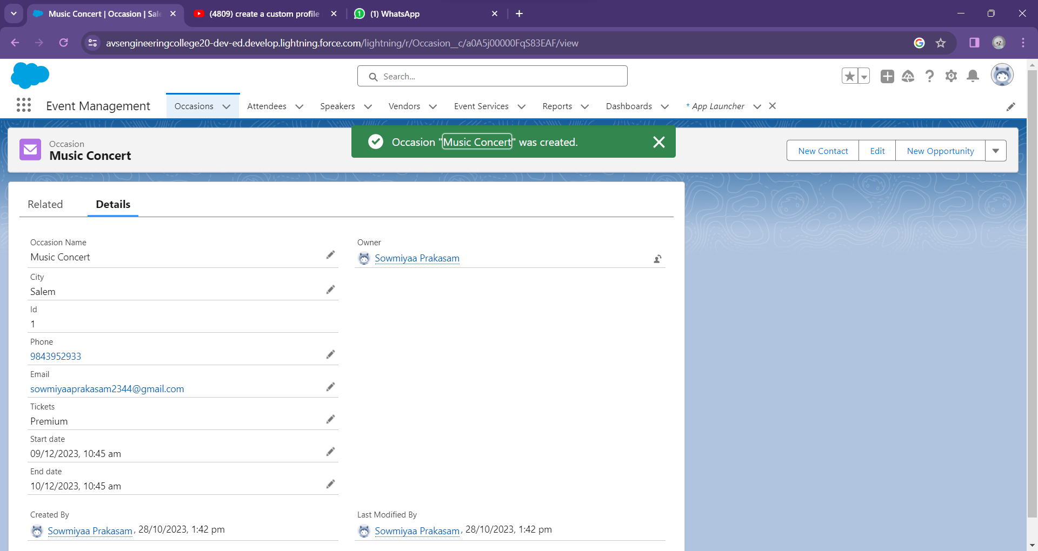
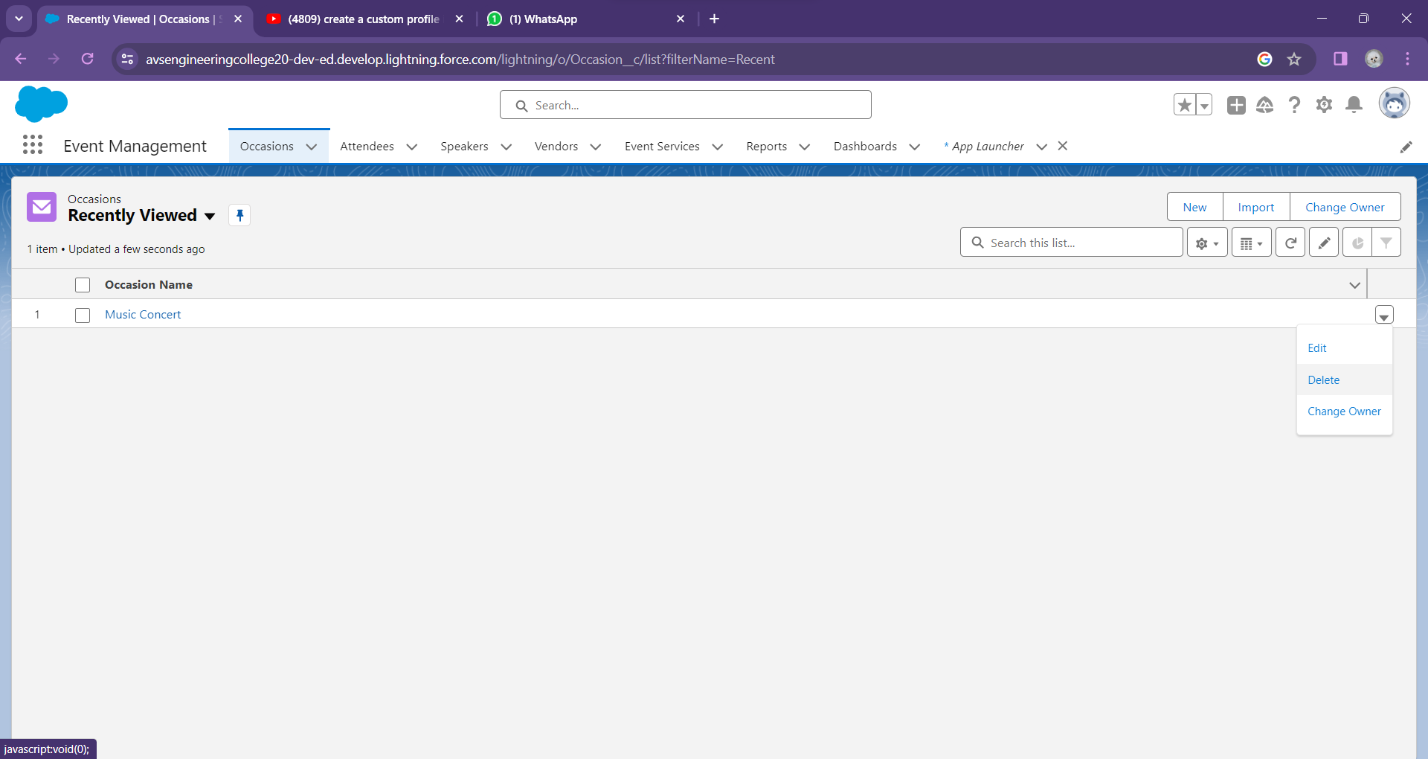
USER ADOPTION:

Slide 12
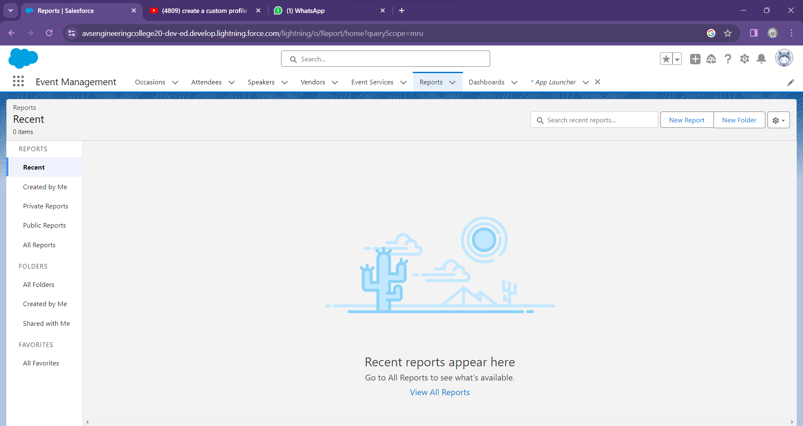
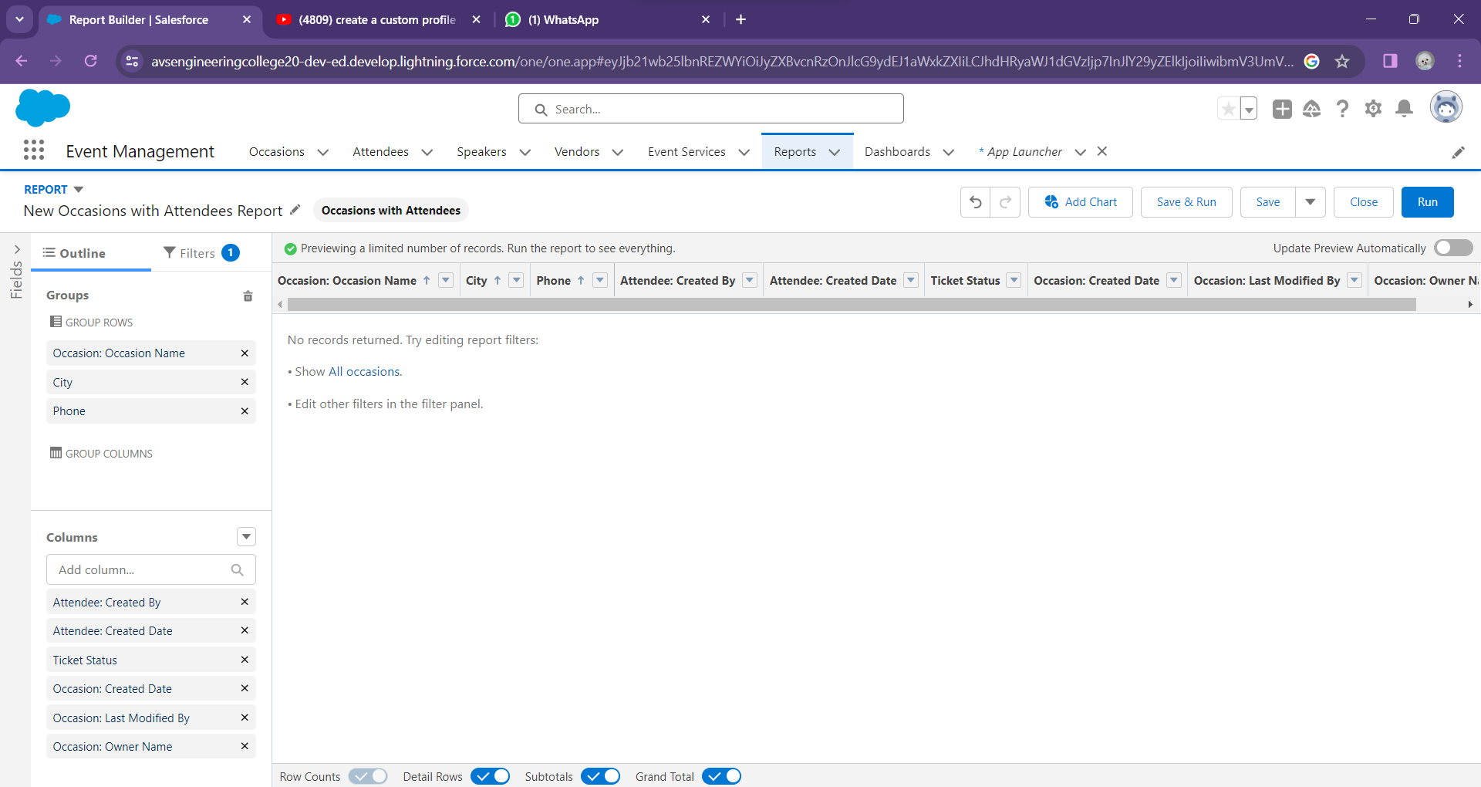
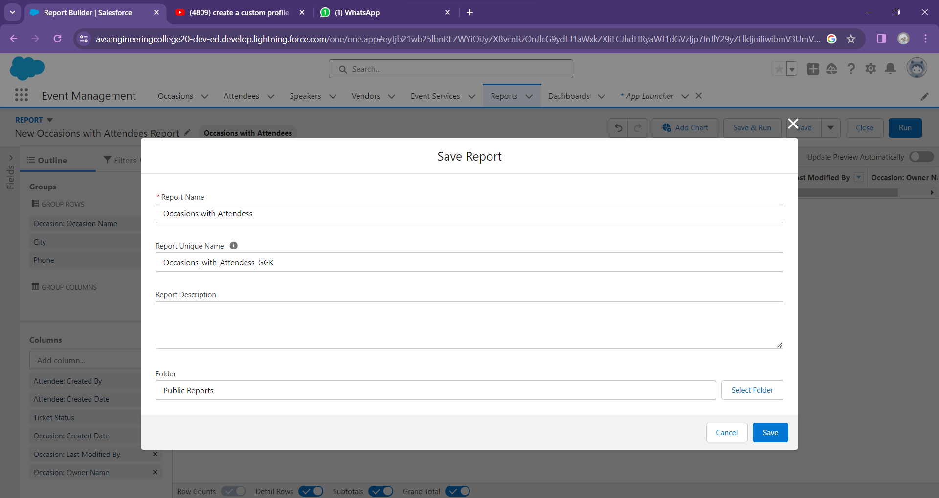
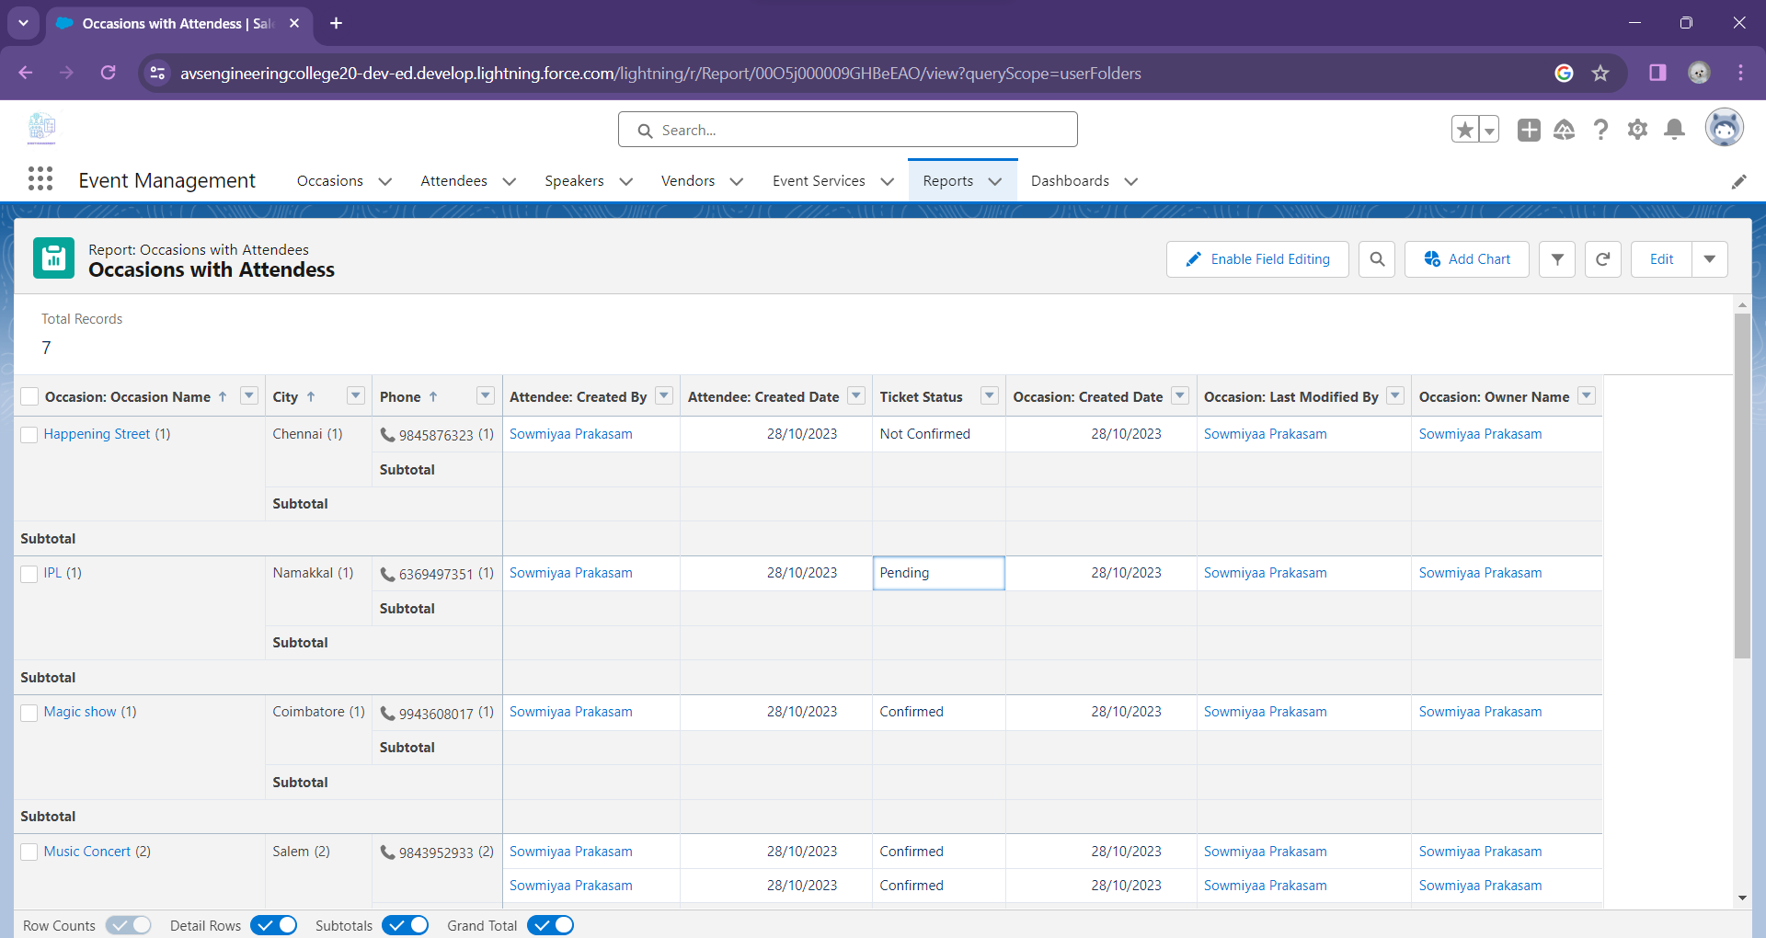
REPORTS:

Slide 13
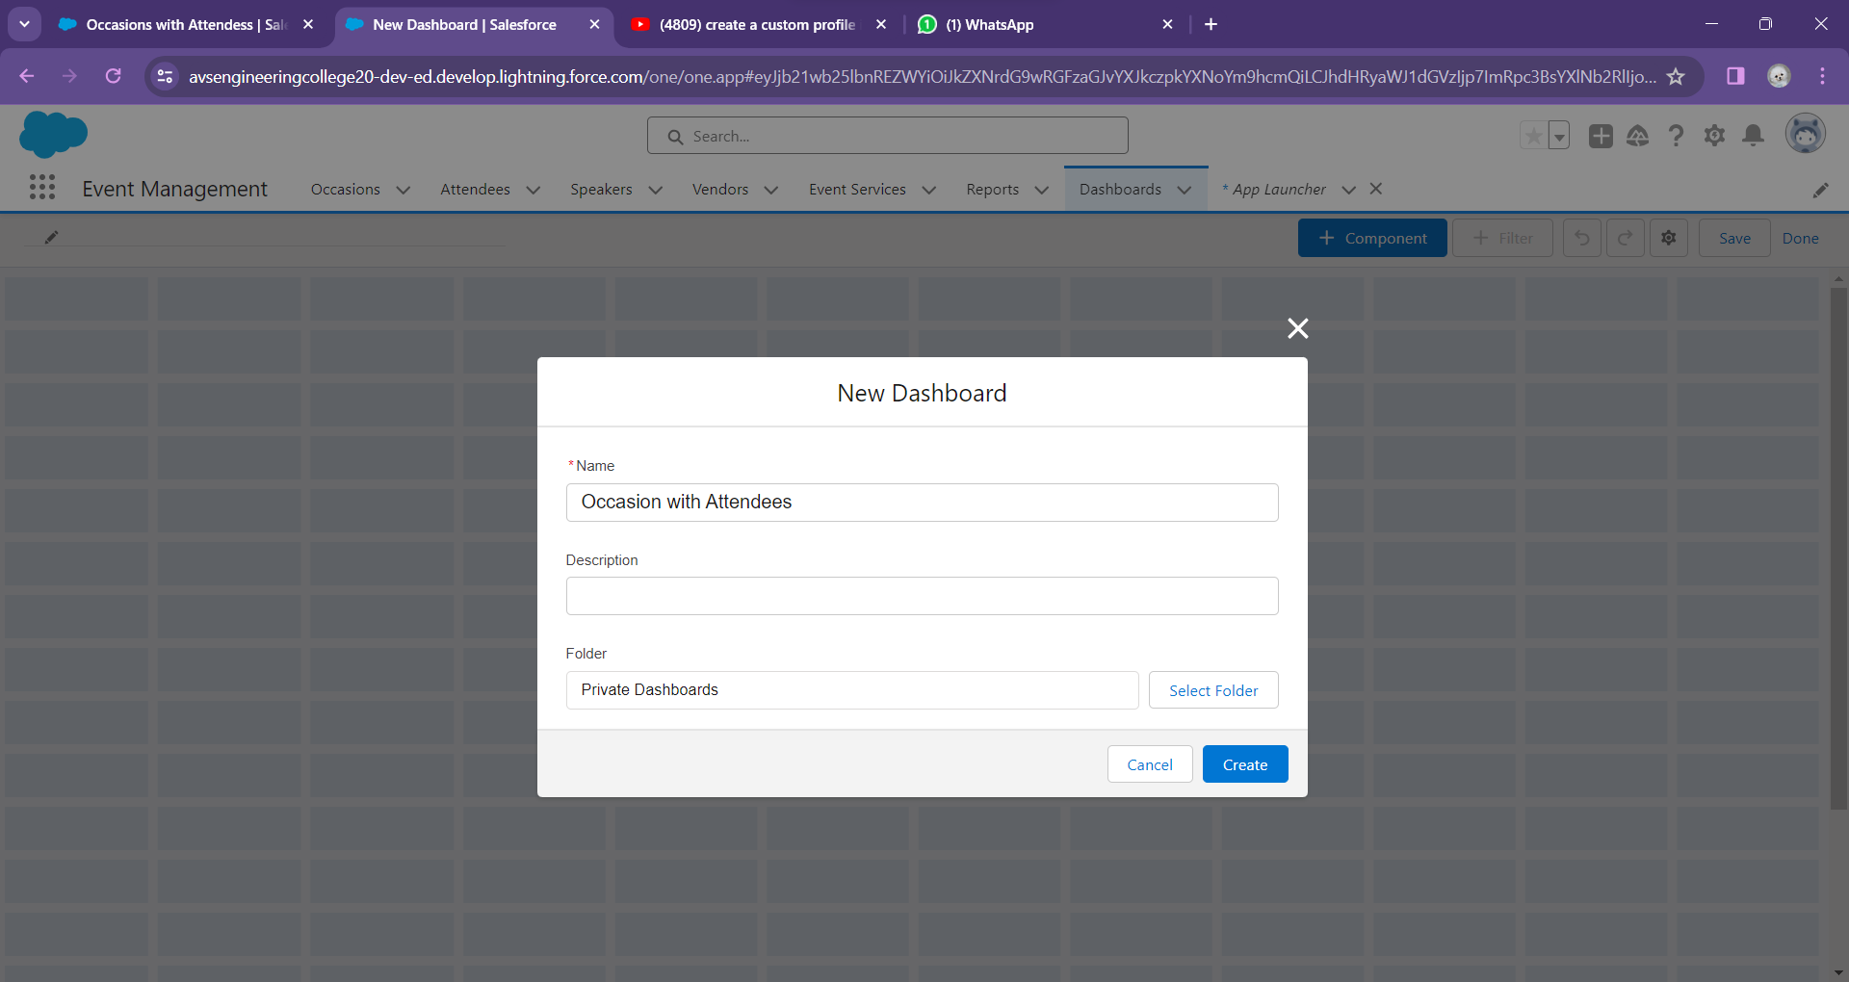
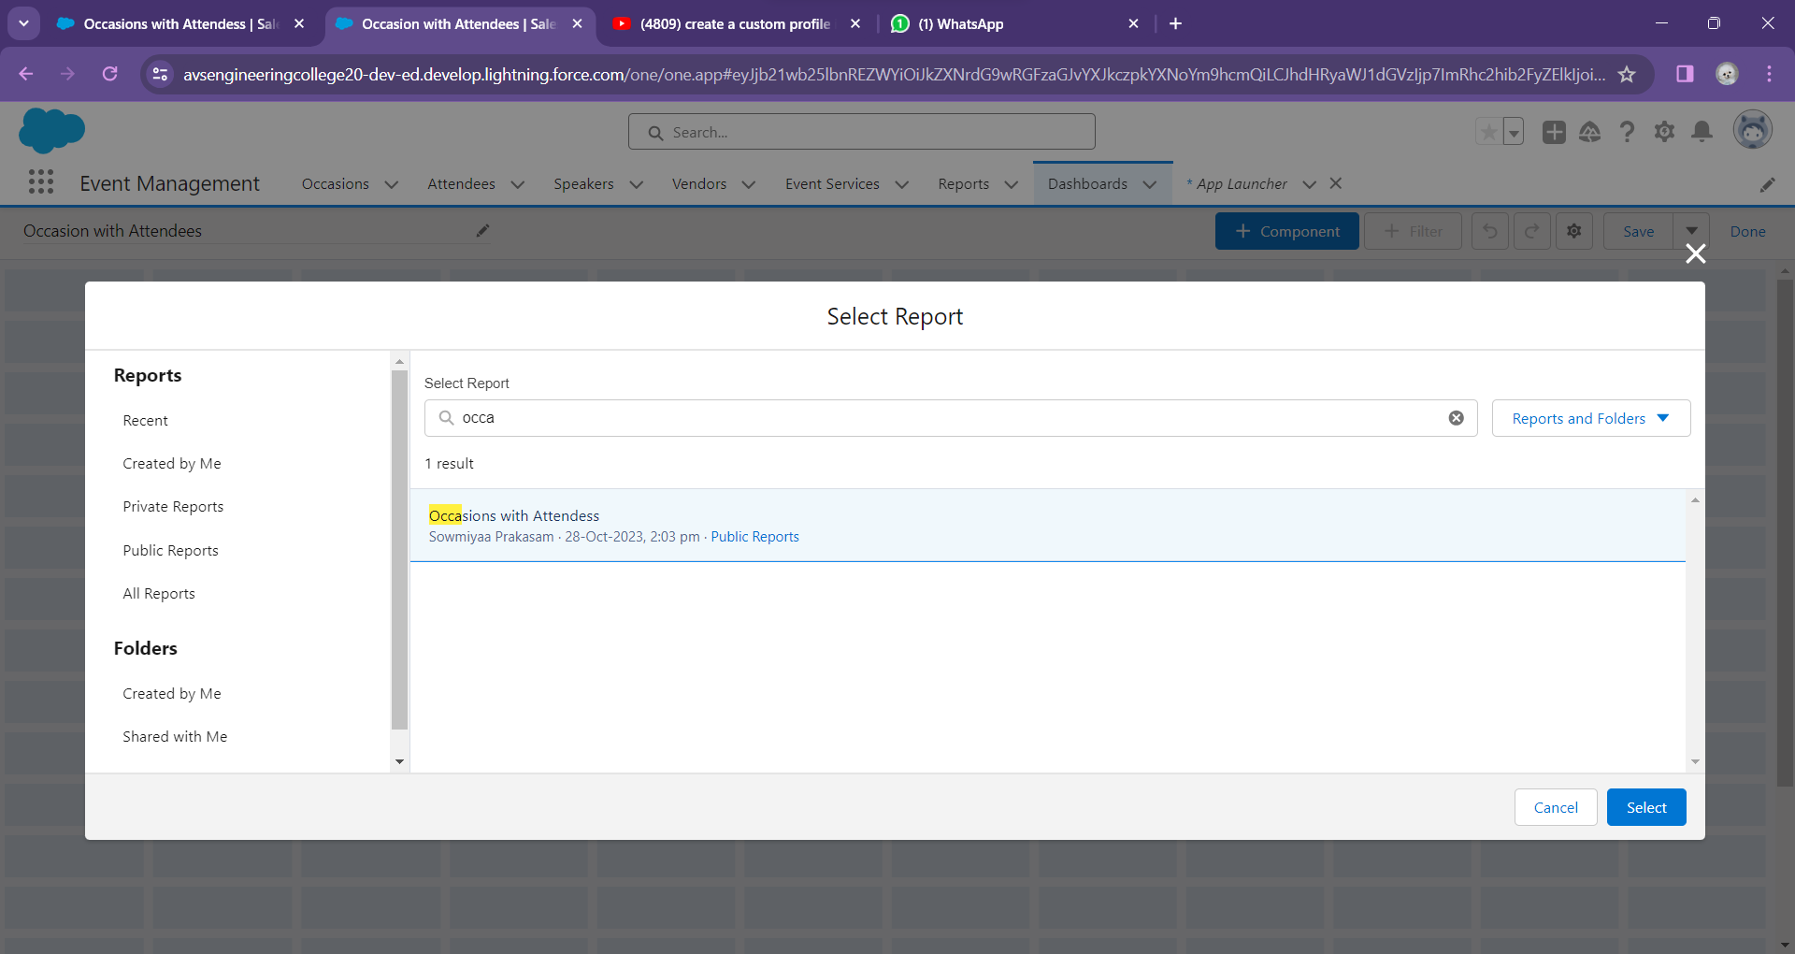
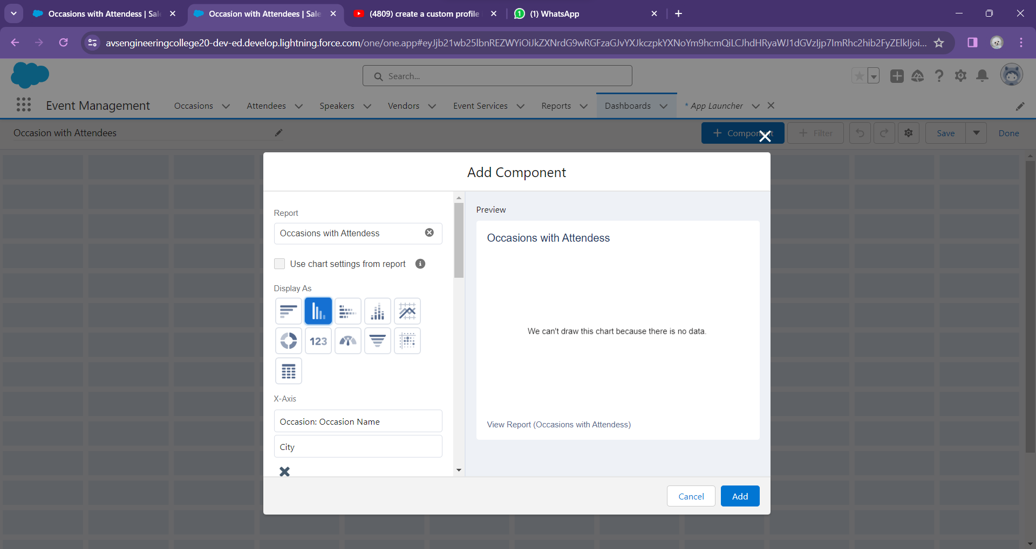
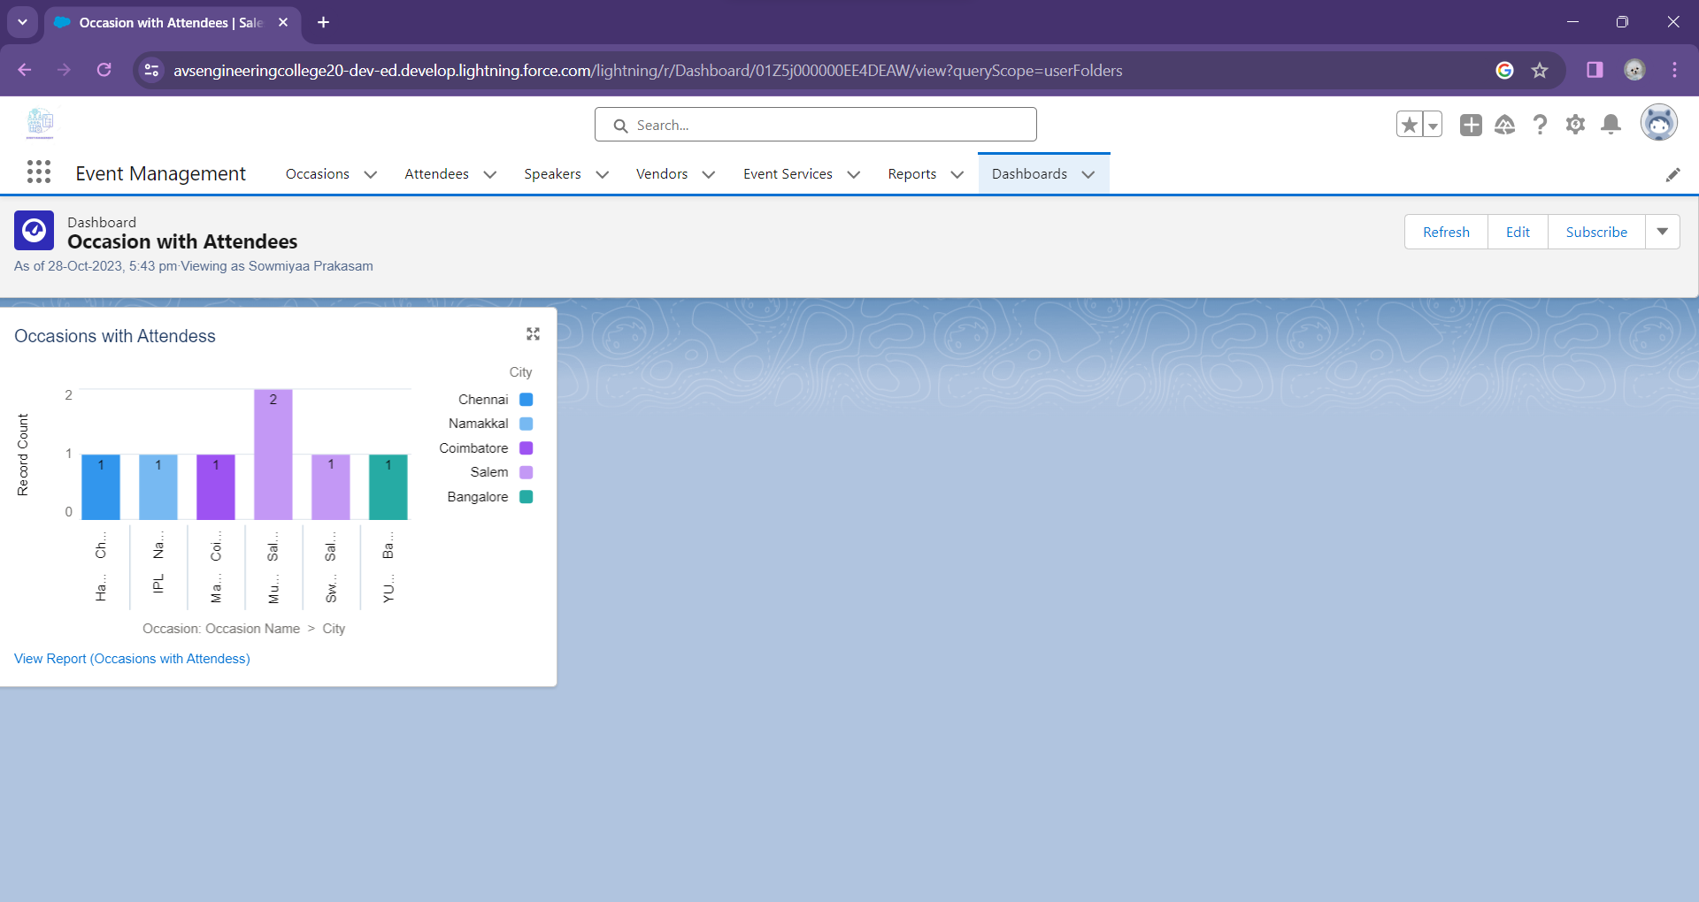
DASHBOARD:

Slide 14
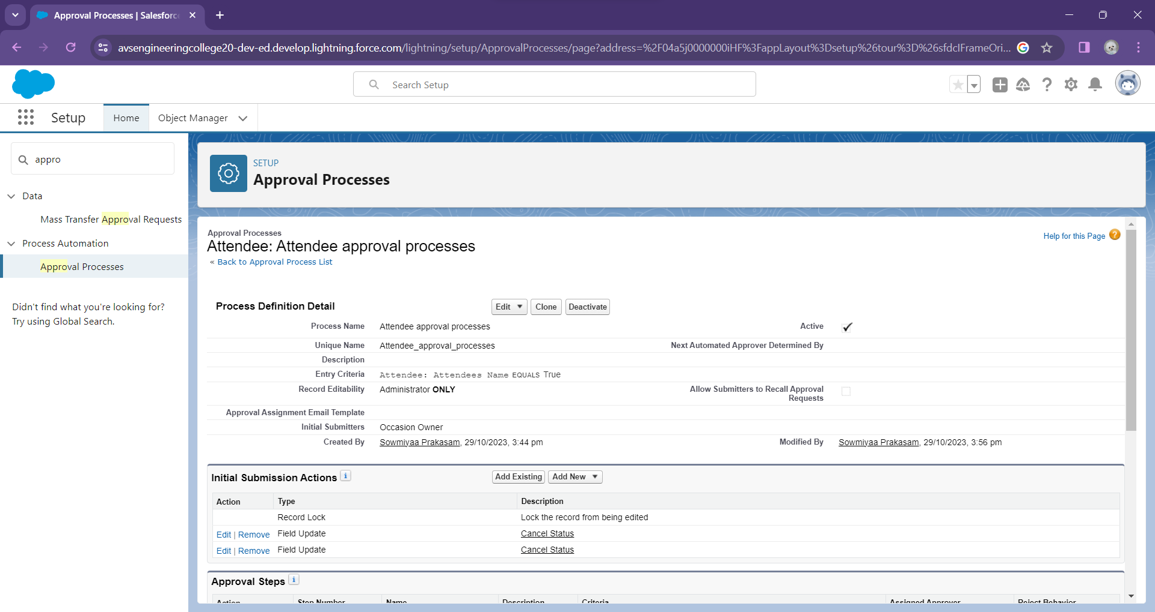
APPROVAL PROCESS:

Slide 15
THANK YOU!

